Slide 1
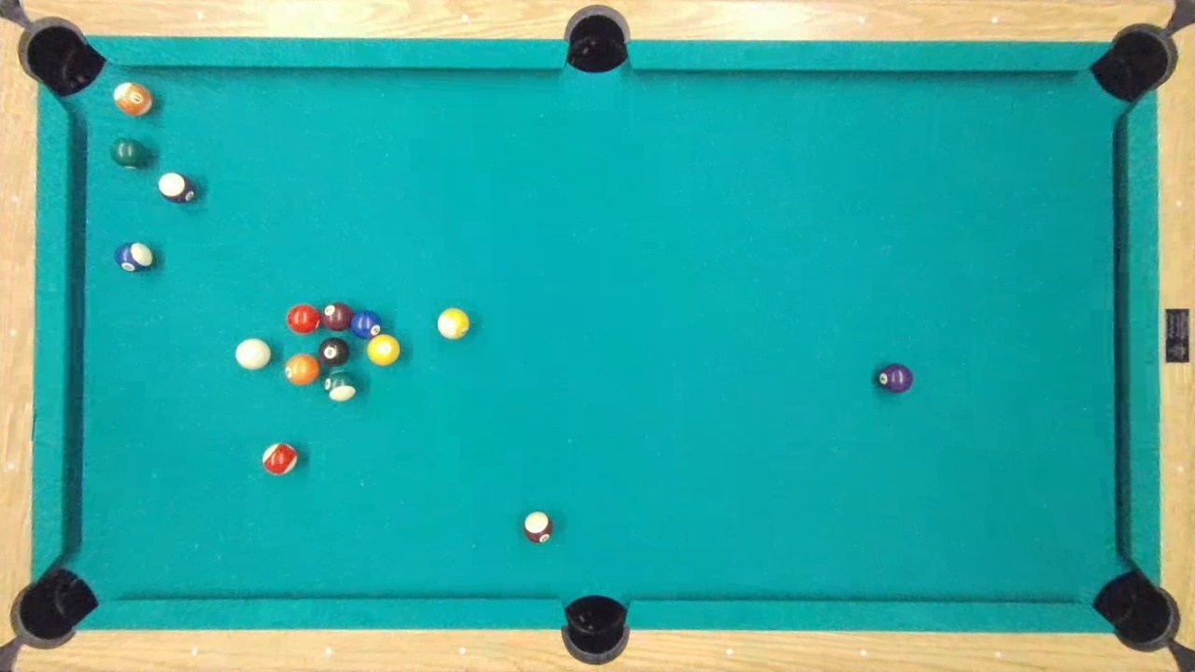
IPVS
Analytic Computing
Fachpraktikum Artificial Intelligence
Billiard Motion Prediction

Slide 2
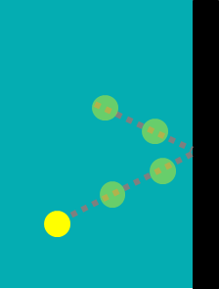
Motivation & Problem Statement
Motivation
Use Artificial Intelligence by learning from data
Implement whole data mining cycle
Application: Motion Prediction of multiple objects
Problem Statement
Billiard balls motion prediction
Input: Short video starting with strike
Output: Ball positions and velocities over time
Regression Goal: Minimize difference between predicted and ground truth trajectory

Slide 3
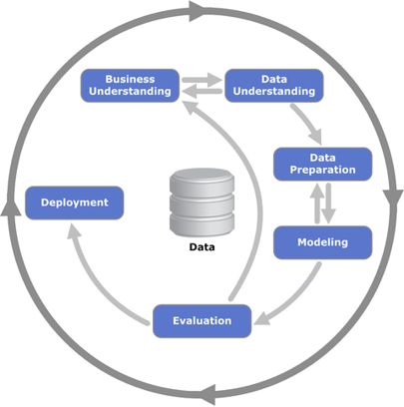




Methodology & Setup
Methodology
CRISP-DM Model
Requirements analyisis
Setup
Tracking of tasks with Trello
Communication via Discord
Scrum with weekly sprint review
Git as collaborative version control system
Modular software architecture
Formal documentation with UML
https://statistik-dresden.de/archives/1128
Notes:
Cross Industry Standard Process for Data Mining
Focus on clear business&data understanding --> Req analysis

Slide 4
Table of contents
Data Preparation
Modeling
Evaluation
Conclusion
Notes:
Structure following the CRISP-DM model
Introduction:
- Motivation & Problem Statement
- Methodology & Setup
Data Preparation:
- Data Collection
- Preprocessing
Modeling:
- BaseNet
- LSTM
- Baselines
Evaluation:
- Rendering
- Multi-step prediction
- Comparison
Conclusion:
- Lessons learned & Future work

Slide 5
Data Preparation

Slide 6
Overview
Video Recording
Clips Generation
Camera Calibration
Distortion Correction
Data Augmentation
Alignment
Preprocessing
Dataset Cleaning

Slide 7
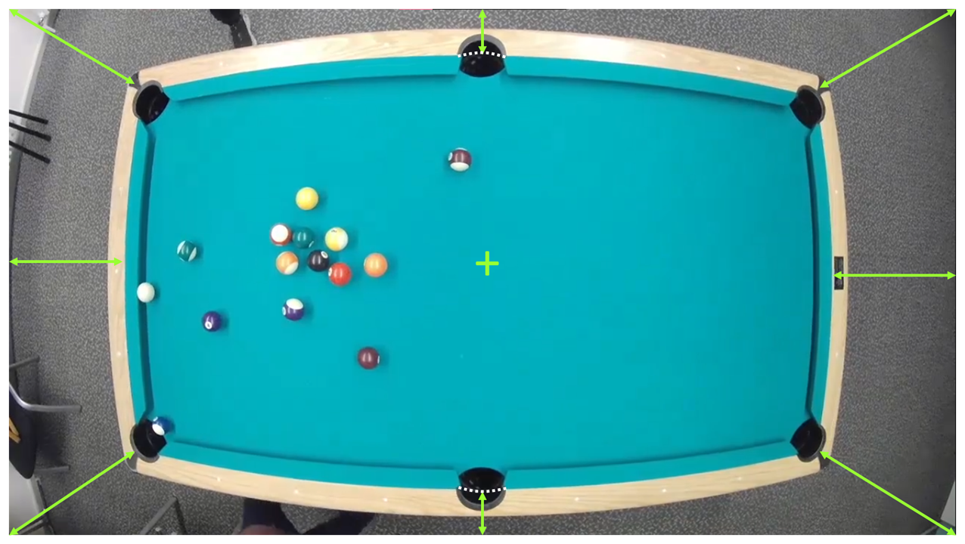
Video Recording
No occlusions
Uniform lighting
Table centered
borders equidistant from image edges
corners equidistant from image corners
Notes:
Points that were considered while video recording:
Camera vision should be free of occlusions.
Uniform lighting conditions all over the table.
Table placed at the center of the field of camera vision.
All 4 table borders should be equidistant from 4 edges of the frame generated.
All 4 table corners should be equidistant from 4 corners of the frame generated.

Slide 8
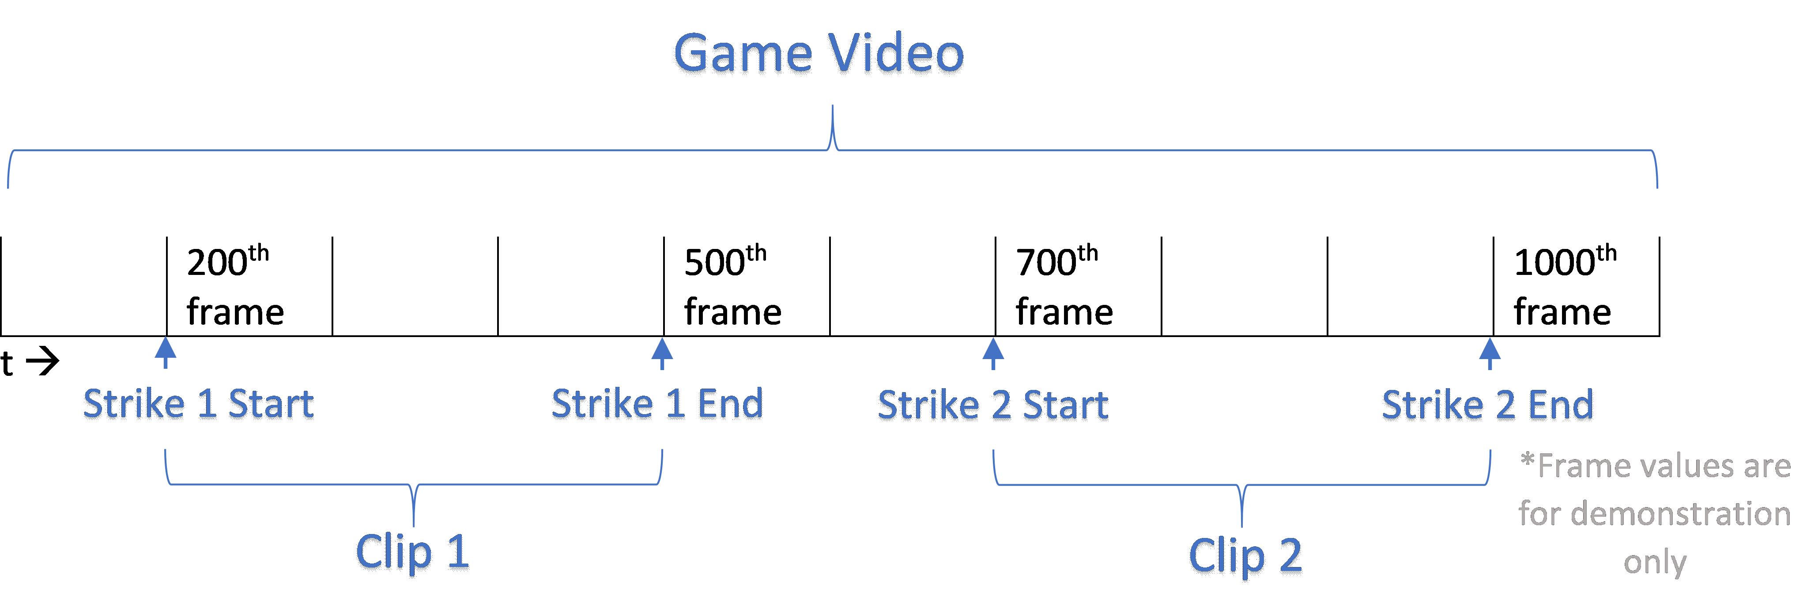
Clips Generation
Timestamps noted manually
Automated video clip generation using python script that accepts timestamps

Slide 9
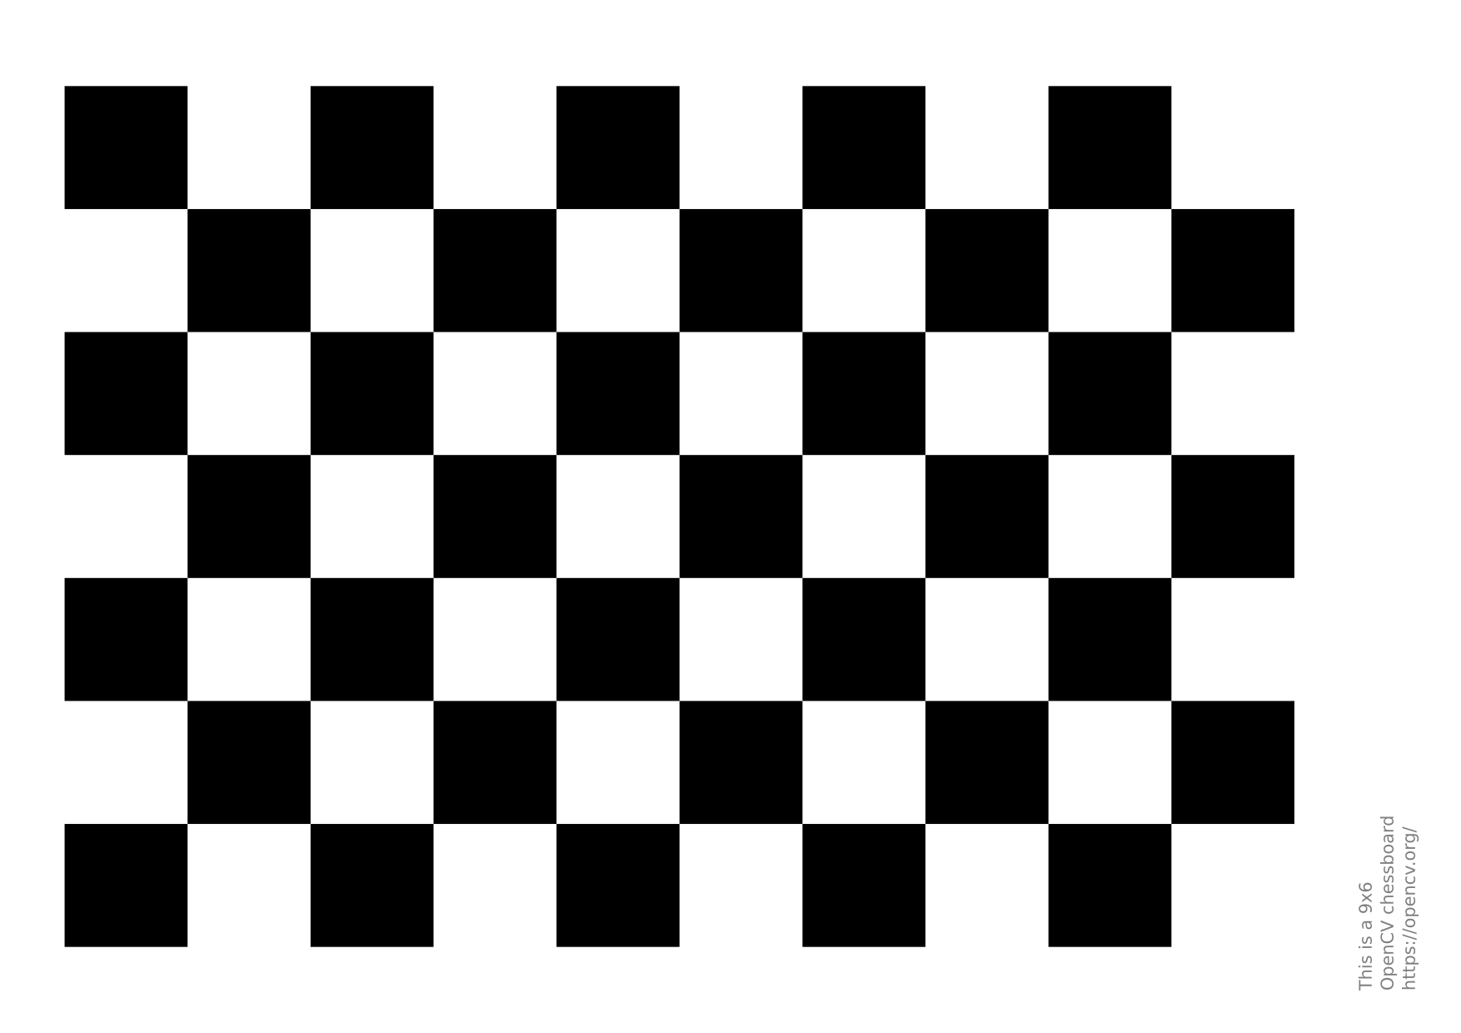
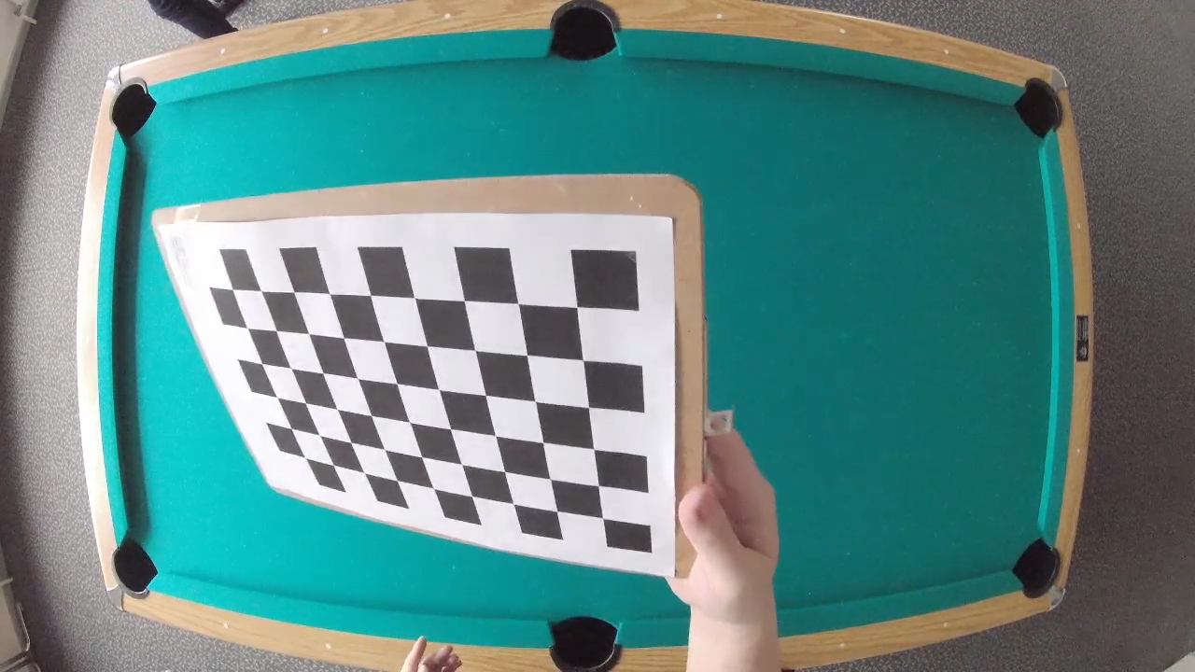
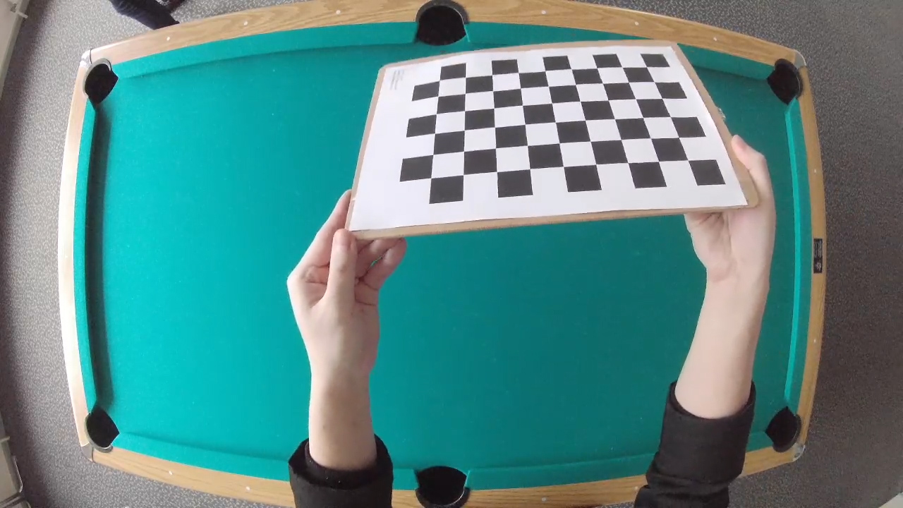
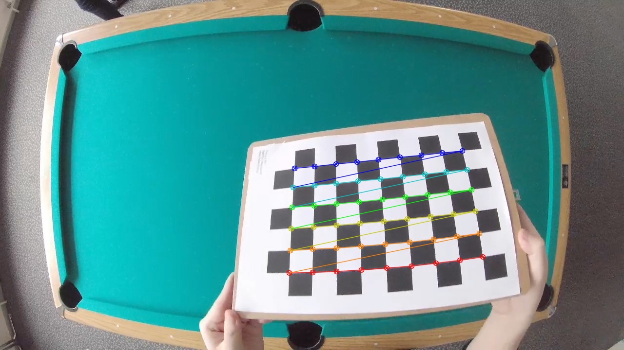
Camera Calibration
Moving chessboard pattern in different angles
Snapshots (10-20) as source
Finding the chessboard pattern positions
Calculating intrinsic of camera: camera matrix & distortion matrix
Chessboard pattern (via opencv.org)
Chessboard patterns images (cut from video)
Found corners

Slide 10
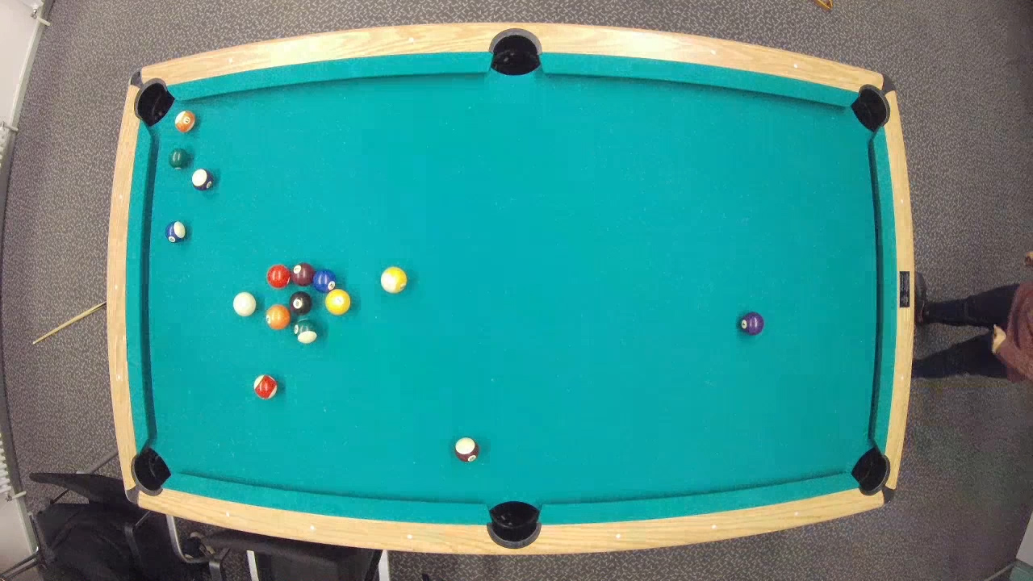
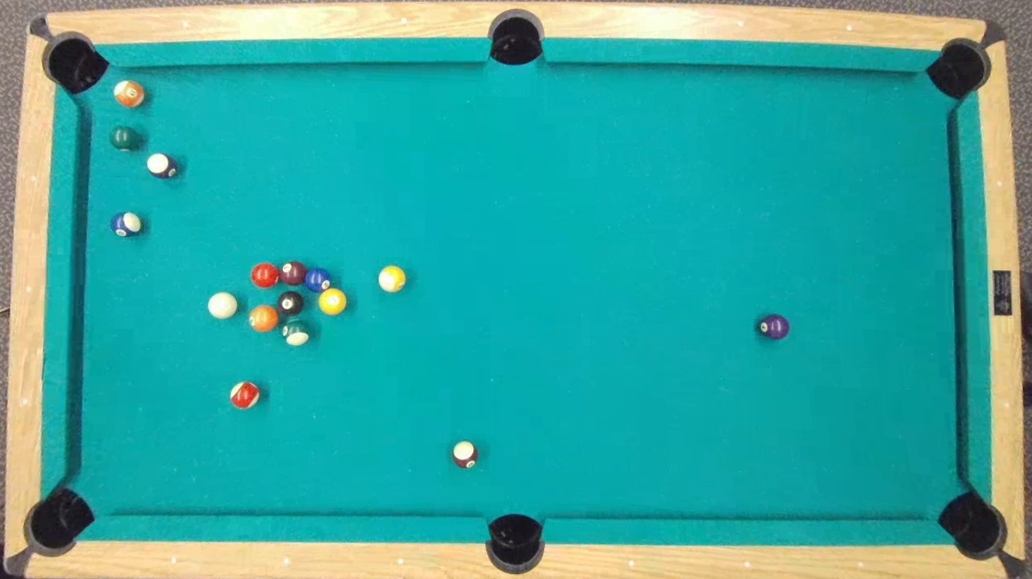
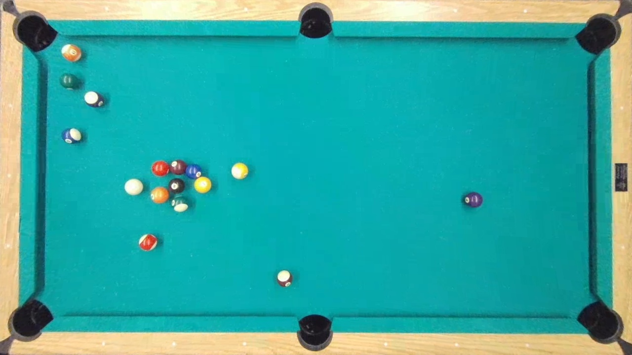

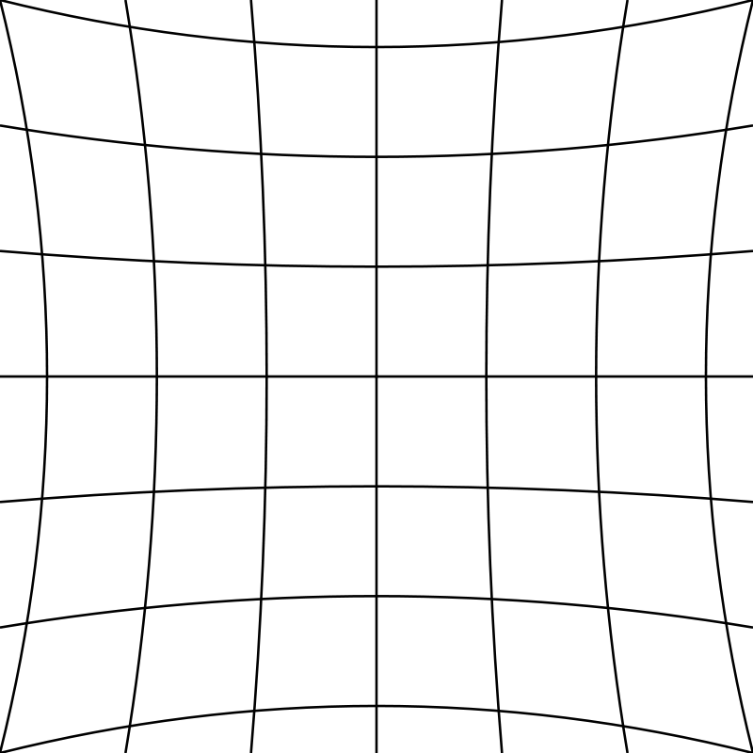
Distortion Correction
Using these two matrices to un-distort the source images
original
Based on 7 images
Based on 14 images
Based on 21 images
→ Increasing number of images improves result

Slide 11
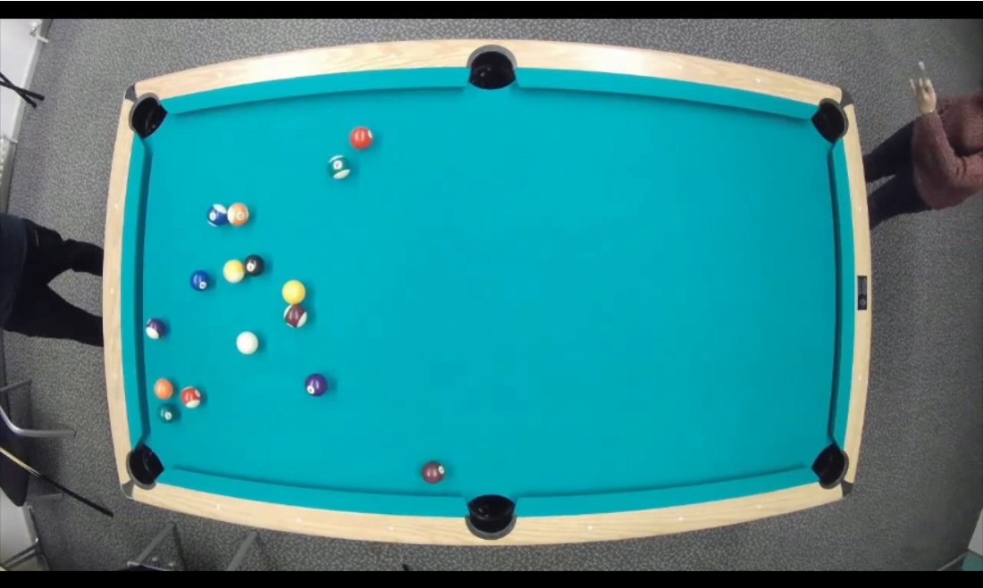
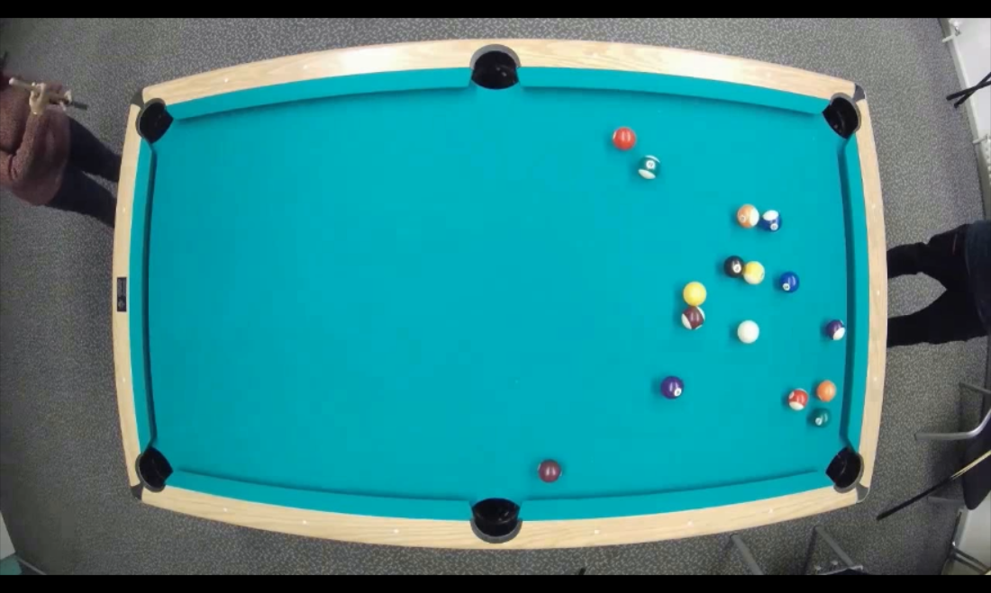
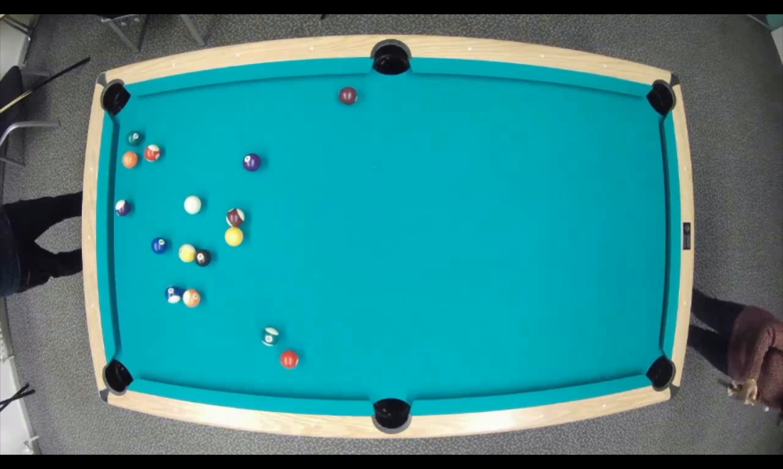
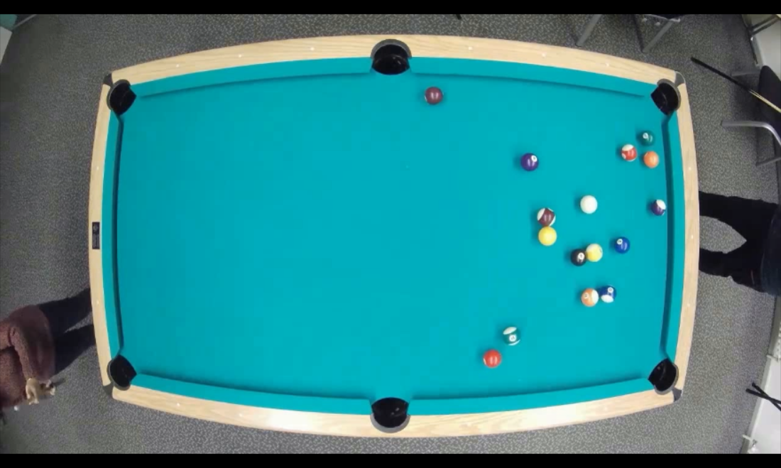
Data Augmentation
original
vertical
horizontal
vertical & horizontal

Slide 12
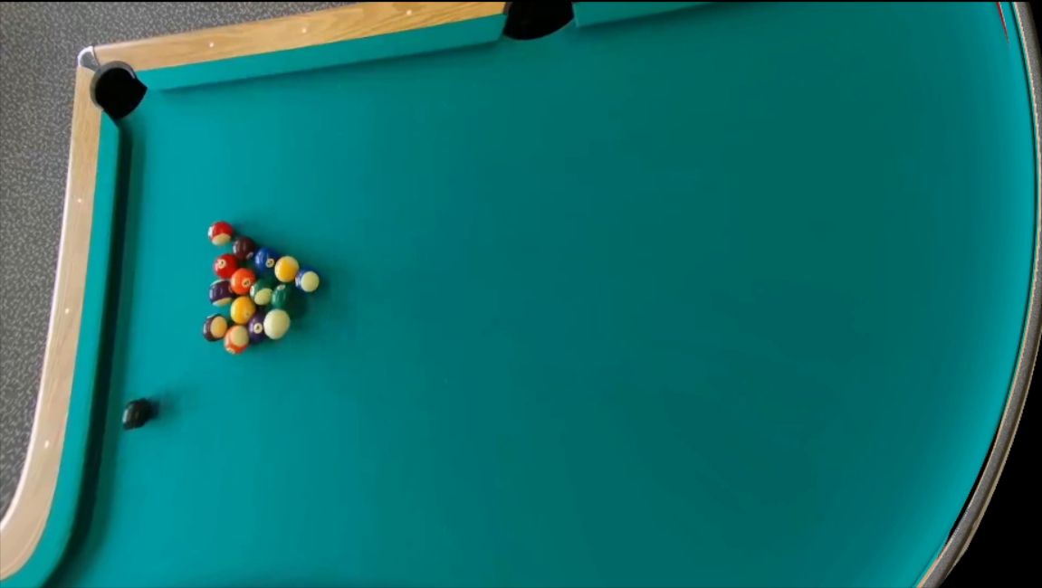
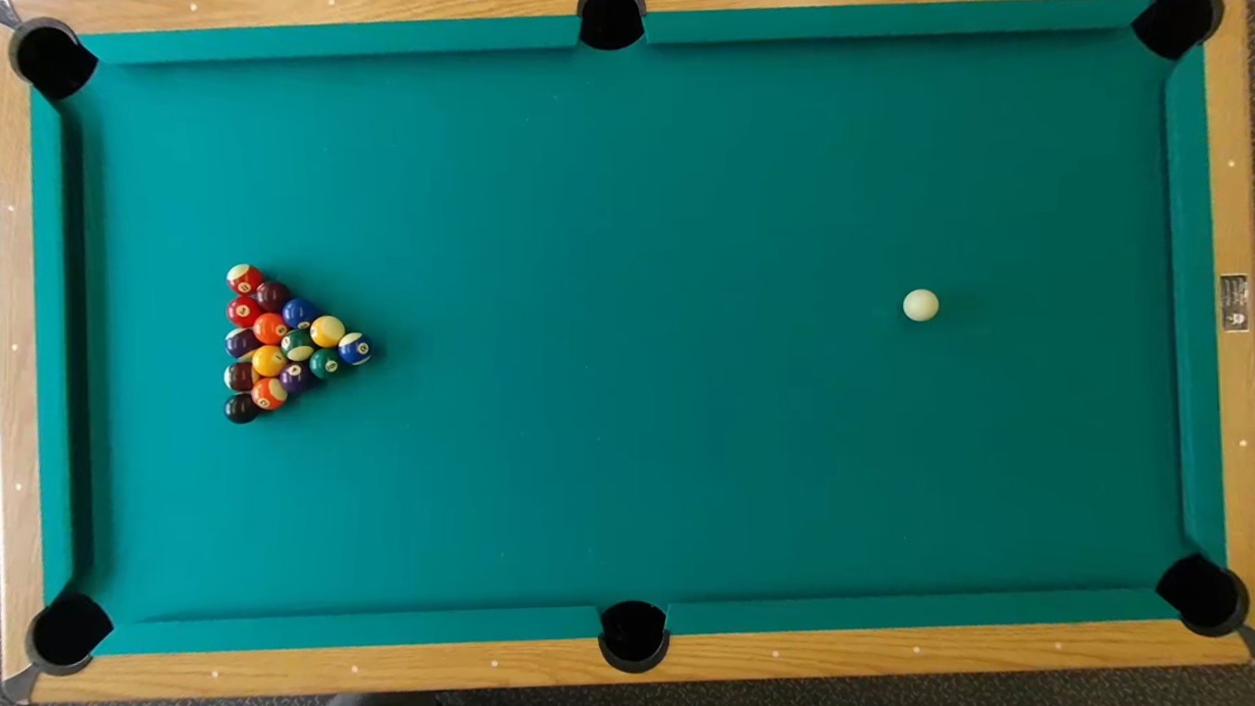
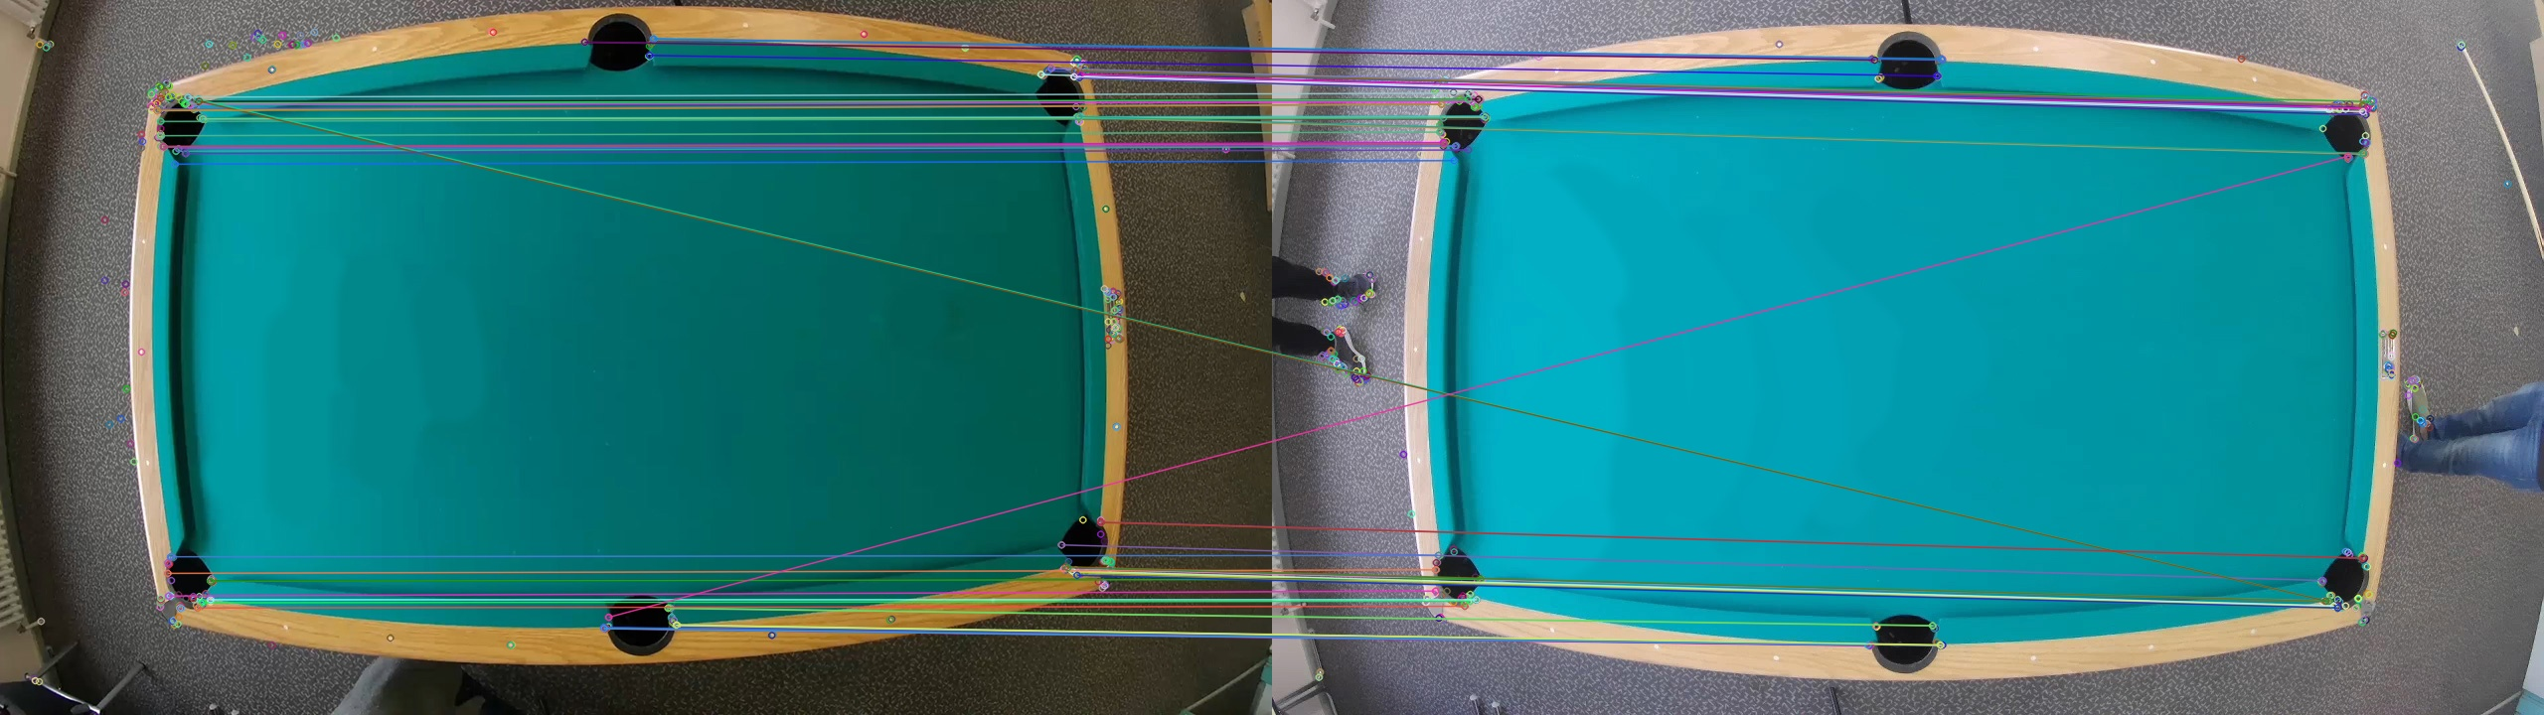
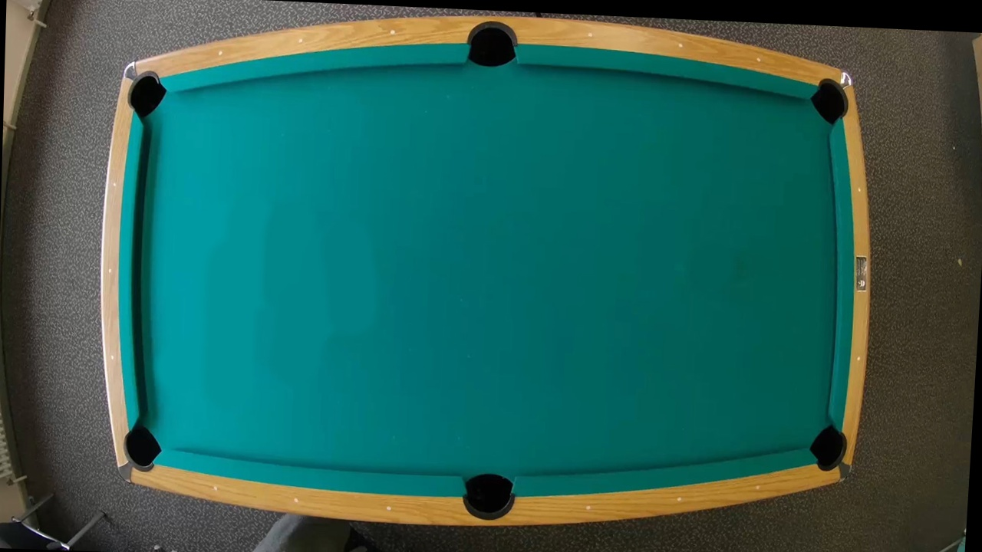
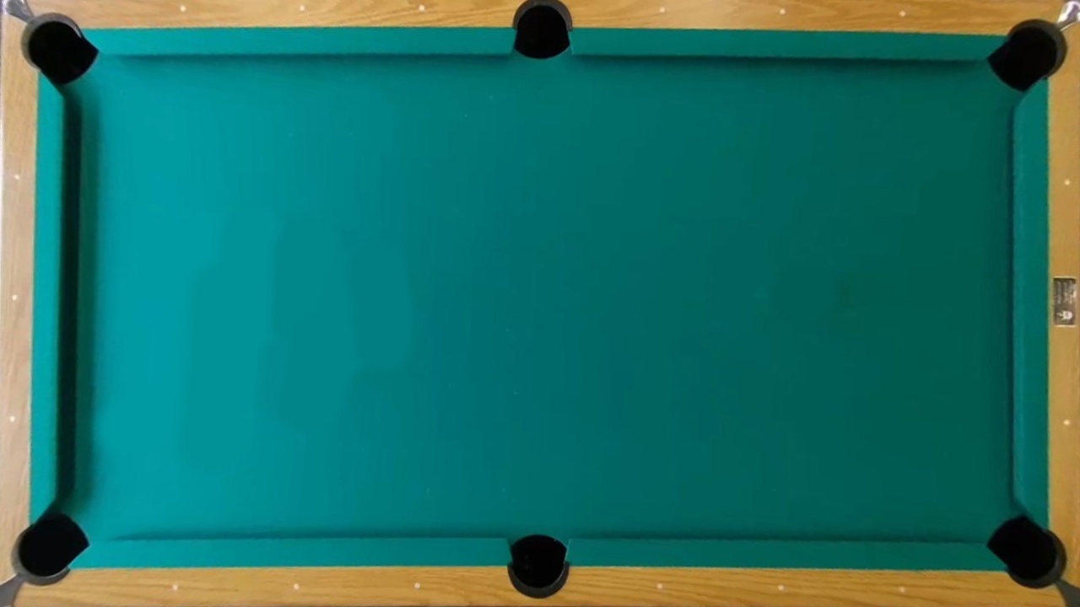
Alignment
Calculating the homograph matrix
Applying it on the source image
Different size
Different angle
Feature matching
Test video
Training video
Alignment result
Correction result

Slide 13
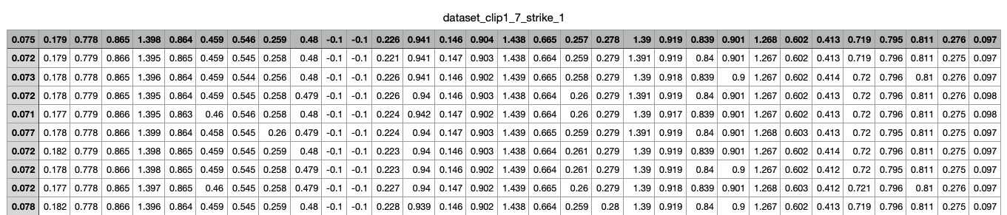
Preprocessing – Overview
Configuration File
Inputs : Clips, Configuration File
Image Processing
Image preprocessing & transformation
Circle detection + Color classification
Bidirectional temporal tracking
Outputs : CSV Files
Preprocessing

Slide 14
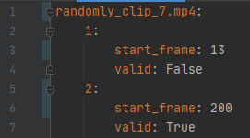
Preprocessing – Inputs
Configuration File Parsing
YAML file containing clip names as entries
Each entry is marked with at-least one:
Start frame
Frame where the strike/s occurs
Valid flag
True : Balls are tracked successfully during the corresponding strike duration, hence csv file can be generated
False : Unsuccessful tracking
Parser extracts the clip name and its metadata
Feeds it to image processing pipeline

Slide 15
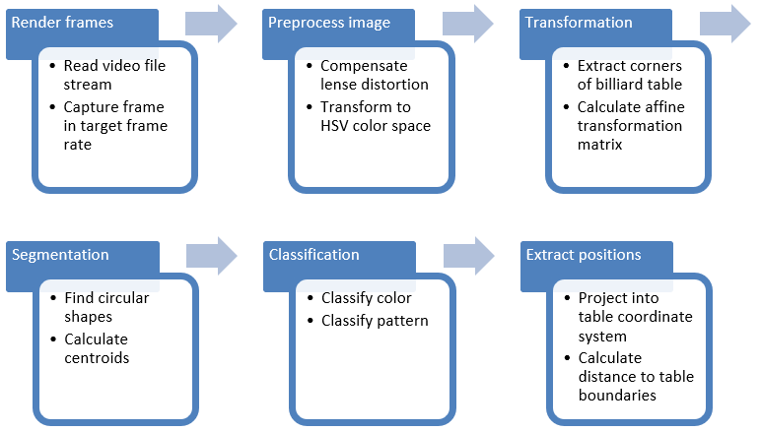
Preprocessing – Pipeline

Slide 16
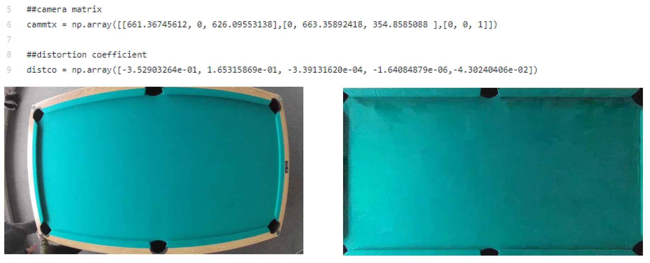
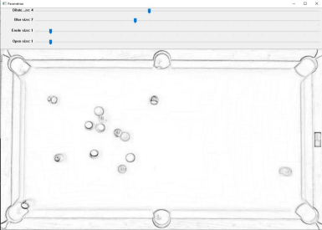
Preprocessing – Image Processing
Preprocess Image :
Camera calibration and distortion correction
Parameterization
Shadow removal
Morphological transformations
Dilation, Blurring, Erosion, Opening
Real time trackbar for adjustment of values
Gamma Correction
Adjustment of contrast in different lightning condition

Slide 17
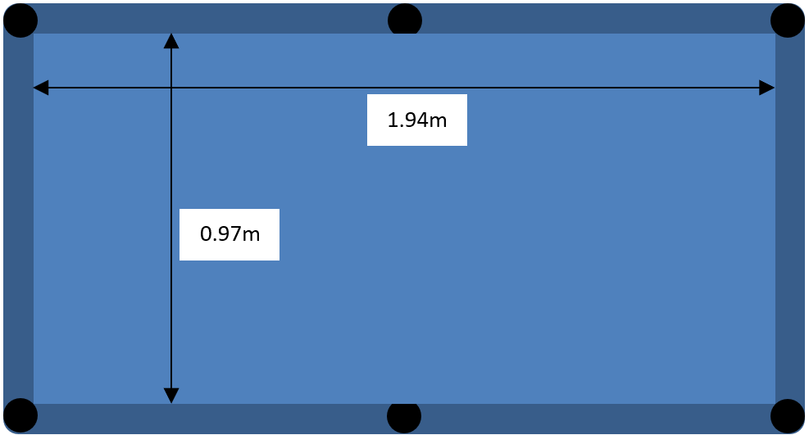
Preprocessing – Image Processing
Find affine transformation matrix to table dimension
Project from image coordinate system to table coordinate system

Slide 18
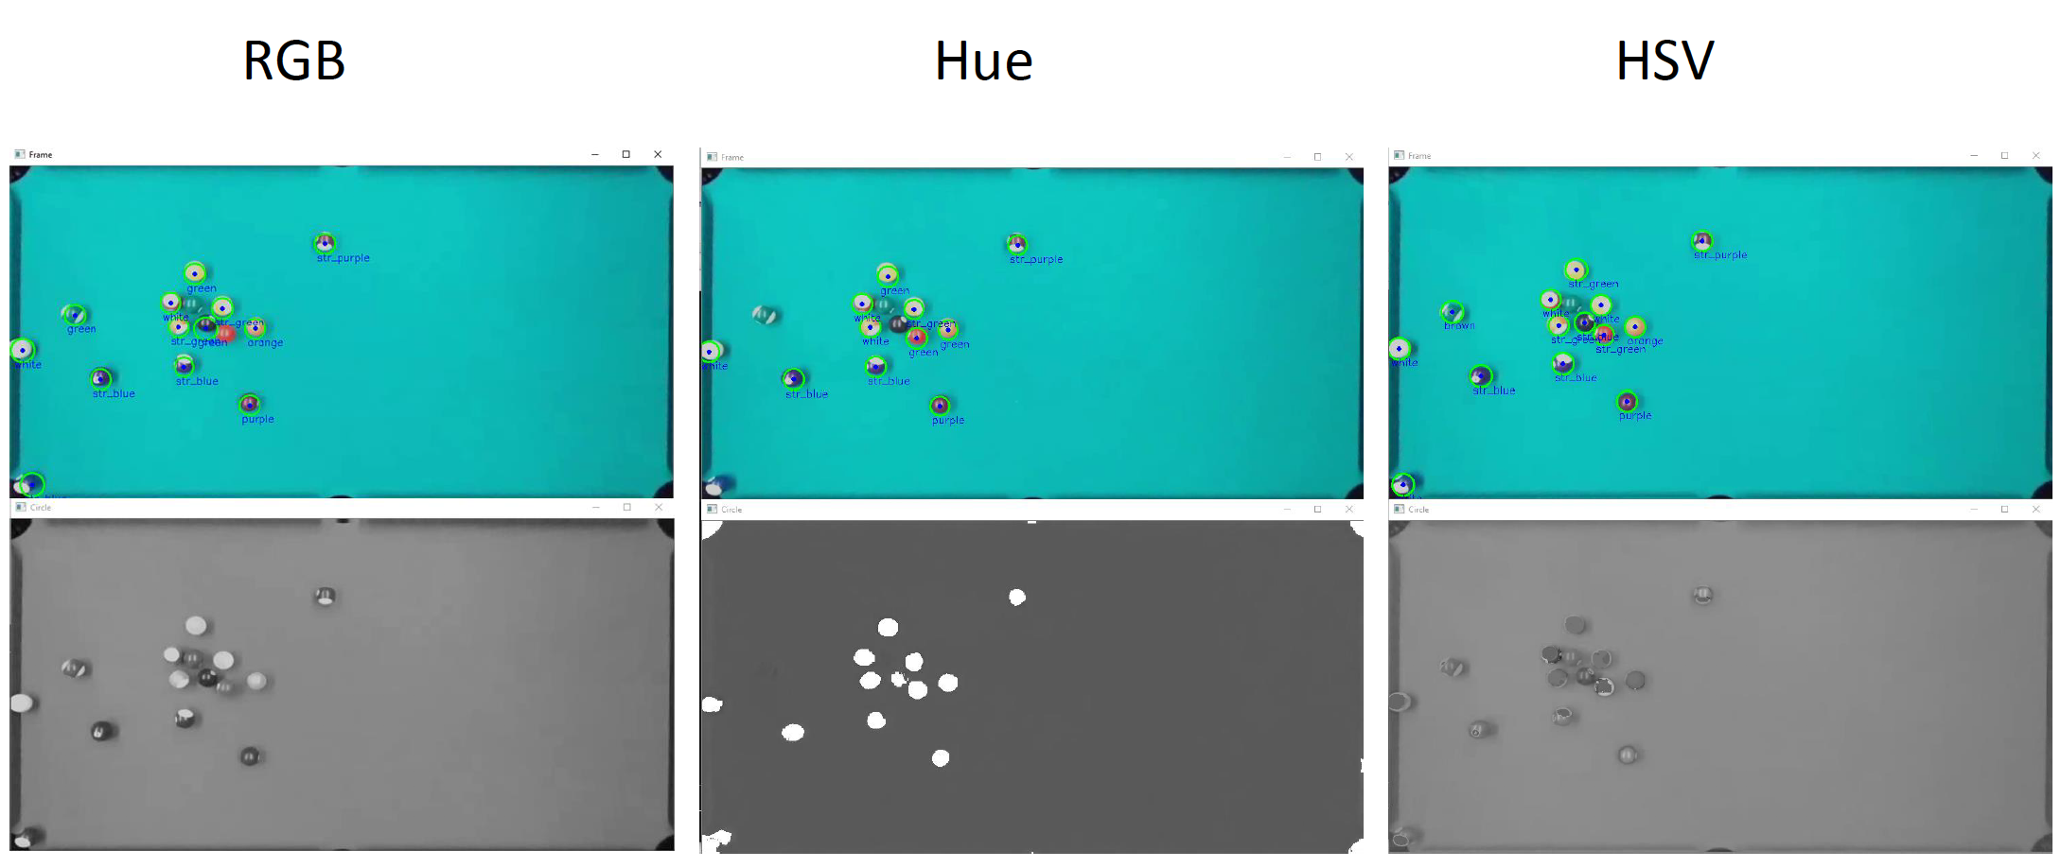
Preprocessing – Image Processing
Circle detection :
Three strategies :
Red-Green-Blue (RGB)
Hue
Hue-Saturation-Value (HSV)
Combine to get noise free frame
Apply 3*3 kernel for blurring
Hough Circle transformation
Parameter tuning
Detect circles
Return centroids and radii

Slide 19
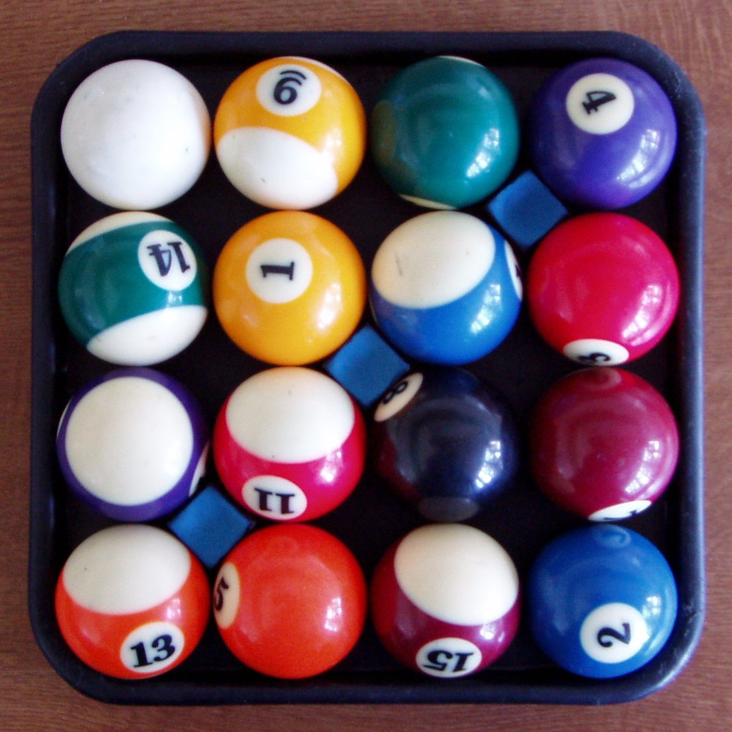
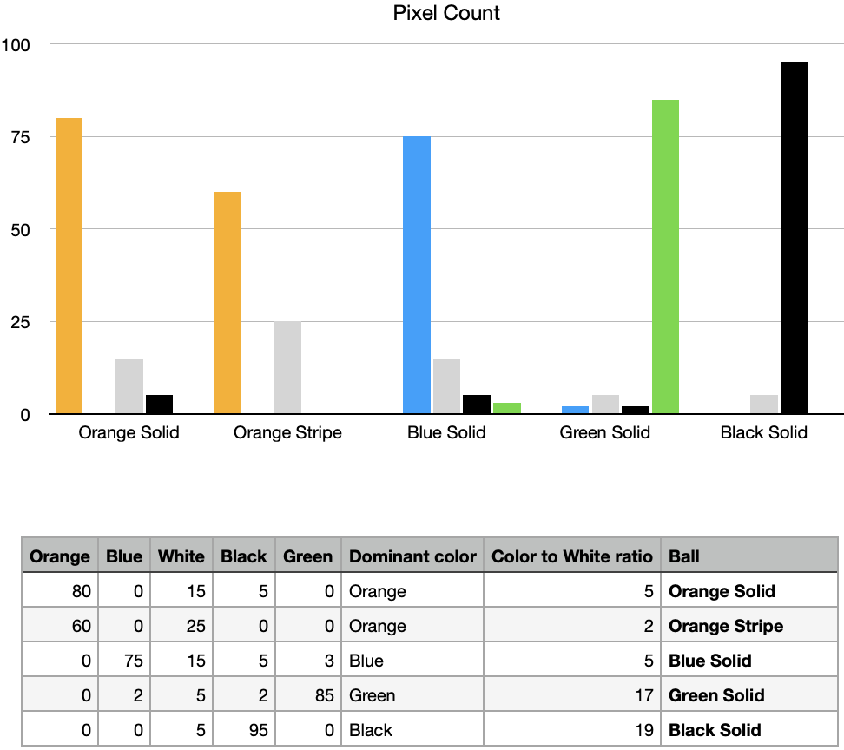
Preprocessing – Image Processing
Color classification :
Mark detected circles as region of interests (ROI)
For each ROI in a frame :
Determine pixels per color using defined Hue, Saturation, Value (HSV) color ranges
Find dominant color and compute color-to-white ratio
Use (2) to classify ball as ball-type
Store ball positions with corresponding ball-type for each frame in a sequence

Slide 20
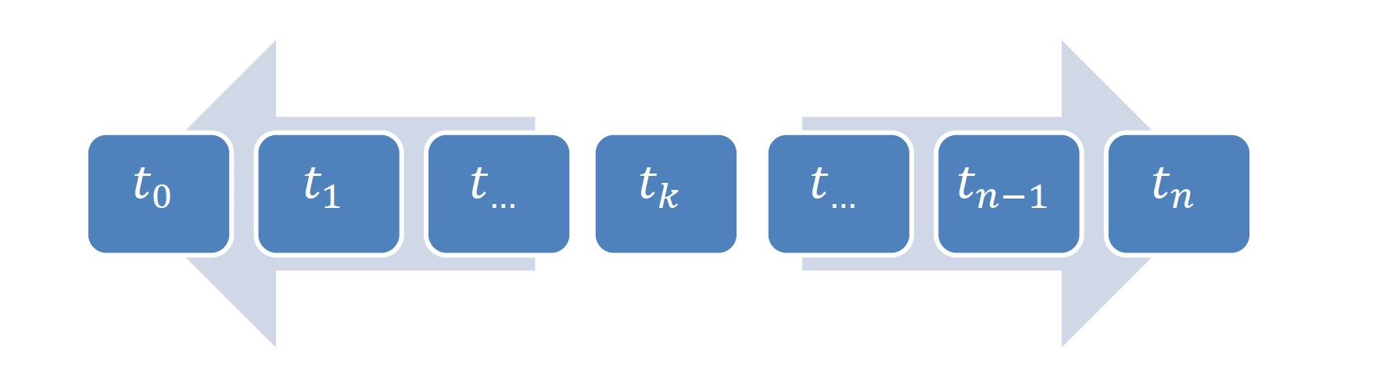
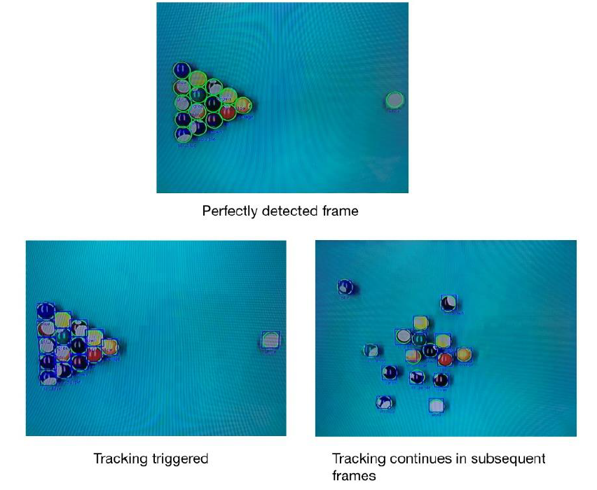
Preprocessing – Bidirectional Temporal Tracking
Need :
To avoid color flickering due to non-robustness of color classification in some of the frames
Steps :
Search across input sequence for best detection frame t_{k}
Initiate backward tracking
Store sequence t₀ to t_{k-1}
Initiate forward tracking
Store sequence t_{k} to t_{n}
Combine both sequences to form entire strike sequence
Tracker used : Channel and Spatial Reliability Tracking (CSRT)
All detected balls are uniquely color-classified

Slide 21
Dataset Cleaning
Problems with the generated dataset :
Hand occlusions (resulting in false positives)
Workaround : Avoid hand occlusions during data collection
Lost trackers (fast movement of balls)
Workaround : Data collected at a higher frame rate
No white ball (White ball misclassified as yellow)
Workaround : Python script which eliminates data with absent white ball
Balls disappearing & reappearing (coming out of holes)
Workaround : Python script which eliminates such data
No movement till 1 sec (30 to 60 frames)
Workaround : Python script which eliminates initial rows with no movement

Slide 22
Modeling

Slide 23
Overview
BaseNet serves as template
Baseline: Naive Model
Baseline: Linear Model
LSTM Recurrent Neural Network Model

Slide 24
Model Inputs & Outputs
Inputs:
Position [5x32]: 5 timesteps, absolute position in x and y for 16 balls
Outputs:
Position [1x32]: 1 timestep, difference in x and y for 16 balls
Is_Moving [1x16]: 1 timestep, moving probability for 16 balls
Prediction "in the loop" → Output used as new input
Notes:
One option we evaluated early in requirements analysis, was to use a approach based on dense data, where we basically feed images into the network.
However, we recognized some drawbacks to this approach, the biggest one being that data will be a bottleneck.
As remedy, we chose sparse data representation by focusing on data preparation to incorporate domain knowledge.
We preprocessed the dense image data as explained before to end up with ball coordinates

Slide 25
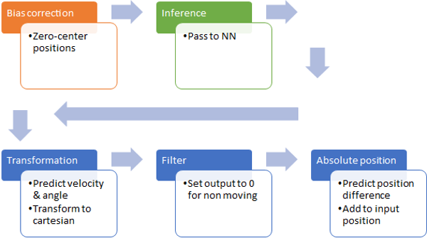
BaseNet
Template for NN implementation → shared across models
Realize preparation of input
Realize transformation of output

Slide 26
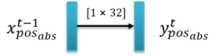
Baseline: Naive Model
In billiard most balls are steady during strike
Constant position is good prior
Naive model gives input as output
Used as reference to quantify

Slide 27
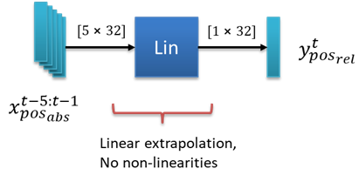
Baseline: Linear Model
Simple linear layer without activation function
Learns extrapolation of position
Underestimates position difference in linear motion case
Disregards non-linearities (collisions, boundaries)

Slide 28
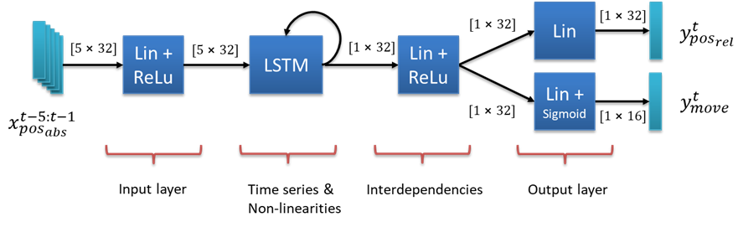
LSTM Model
Recurrent cell to capture non-linearities across time series
Linear layers before and after LSTM to prepare and inter-combine features
No activation function applied to position output to learn linear mapping
Output includes is_moving per ball as probabilistic estimate

Slide 29
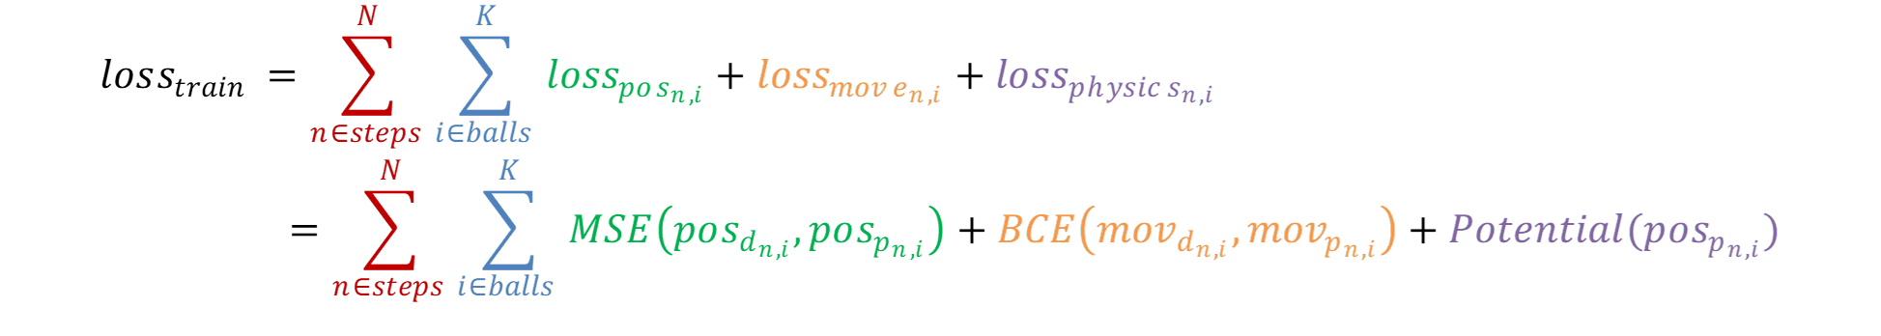
Loss Function
Evaluation metric: Avg. Euclidean position error
Position: RMSE
Training loss: Joint loss accumulated over N training steps and K balls
Position: Mean Squared Error
Moving: Binary Cross Entropy
Physical constraints: Potential map
Notes:
Regression task --> MSE

Slide 30
Evaluation

Slide 31
Overview
Model performance is evaluated:
Quantitatively: Compare evaluation metric to baselines
Qualitatively: Subjective plausibility of predicted videos
Predicted videos instrumental to figure out current state and weaknesses of the model
Rendering toolbox developed to compare model to ground truth
Easily visible:
Linear movement
Collisions with boundaries/balls
Stationary balls
Prediction flaws in video guide adjustments of training

Slide 32
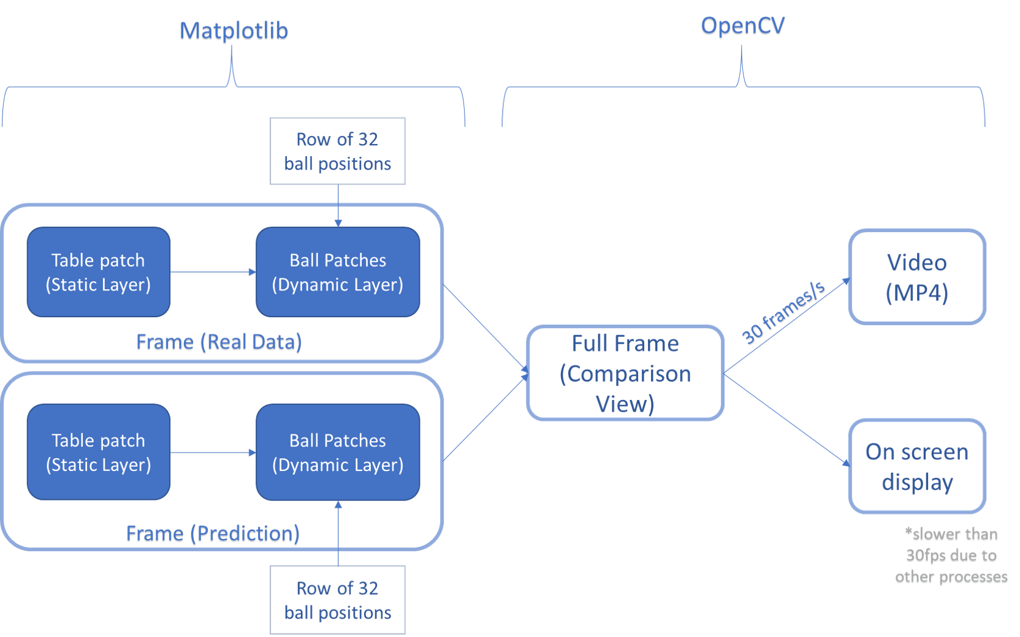
Rendering

Slide 33
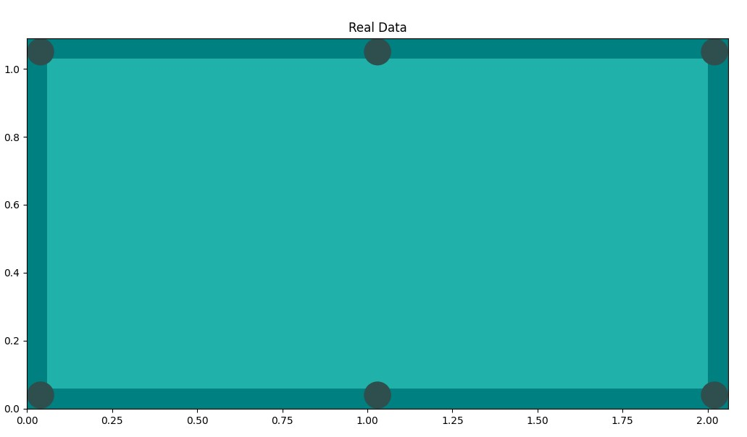
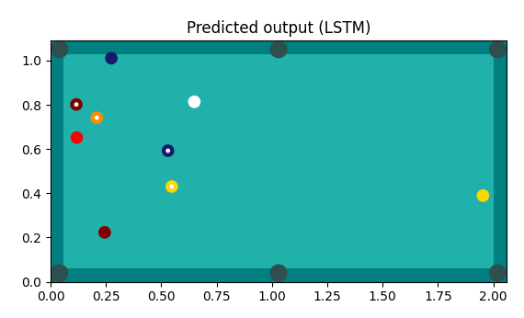
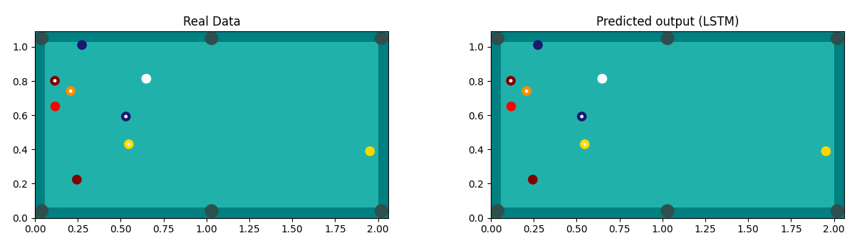
Static Layer
Dynamic Layer
Comparison View

Slide 34
Multi-step prediction
Two prediction modes for evaluation:
"In-the-loop" prediction of entire strike after initializing with the first 5 frames:
t-4
t-3
t-2
t-1
t0
t1
Ground Truth
Rendered frame
t-3
t-2
t-1
t0
t1
t2
t-2
t-1
t0
t1
t2
t3
t1
t2
t3
...
Video

Slide 35
Multi-step prediction
Two prediction modes for evaluation:
N-step prediction with ground truth as initialization for each predicted frame:
t-9
t-8
t-7
t-6
t-5
t-4
t-3
t-2
t-1
t0
t1
Ground Truth
Intermediate predicted frames
Rendered frame
t-8
t-7
t-6
t-5
t-4
t-3
t-2
t-1
t0
t1
t2
t-7
t-6
t-5
t-4
t-3
t-2
t-1
t0
t1
t2
t3
t1
t2
t3
...
Video

Slide 36
Modeling-Validation Cycle
Multiple cycles in CRISP-DM model:
Initially not enough data
Modeling of non-existing balls with large position → set very small position
Inconsistencies in data found → clean data with scripts
Insufficient performance of tracker → use higher recording framerate
Model instable → predict relative instead of absolute positions
Disregards non-linearities → extend loss function with physical regularization
https://statistik-dresden.de/archives/1128

Slide 37
Comparison to Baseline
Baseline naive→ steady state, actually good
Baseline linear → learns linear motion
LSTM recurrent → learns non-linear collisions
No detailed quantitative analysis available yet due to:
Delayed/restricted data collection (COVID)
Complex data preparation
Build generic model pipeline
Limited dataset size
→ We created starting point for future work

Slide 38
Conclusion

Slide 39
Conclusion
Lessons learned
Pandemic adds difficulty (delayed data collection, pure virtual collaboration)
Data creation and preparation takes time
Lack of data is limitation for sophisticated NN architectures
Future work
Incorporate more physical constraints (e.g., conservation of momentum)
Further DL architectures: Transformer, Graph Neural Network
Thank you!

Slide 40
Demo

Slide 41
Backup

Slide 42
Demo
Show data preparation pipeline
Code walkthrough
Recorded videos
Preprocessing -> Ashish to prepare
Show Rendering
Show video of early model
Show LSTM with nonlinearity
Show constant baseline
Show Linear baseline

Slide 43
Data Preparation - Video Recording
Camera Device: GoXtreme Black Hawk 4k+
Software: OBS Studio
Table measurements: 194cm x 97cm
Ball diameter: 5.7 cm
Several games were played with 600+ strikes
Camera orientation: Points that were considered while video recording: - Table should be free of occlusions - Uniform lighting conditions all over the table - Table placed at the center of the field of camera vision - All 4 table borders should be equidistant from 4 edges of the camera field of vision.
Frame rate: Initially videos were recorded at 30fps, which wasn’t suitable for preprocessing so later videos were recorded in 60 fps
Video Resolution: 1280 x 720

Slide 44
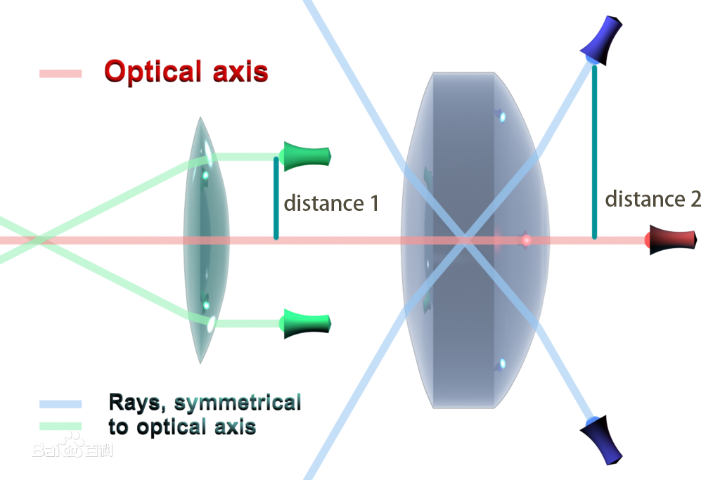
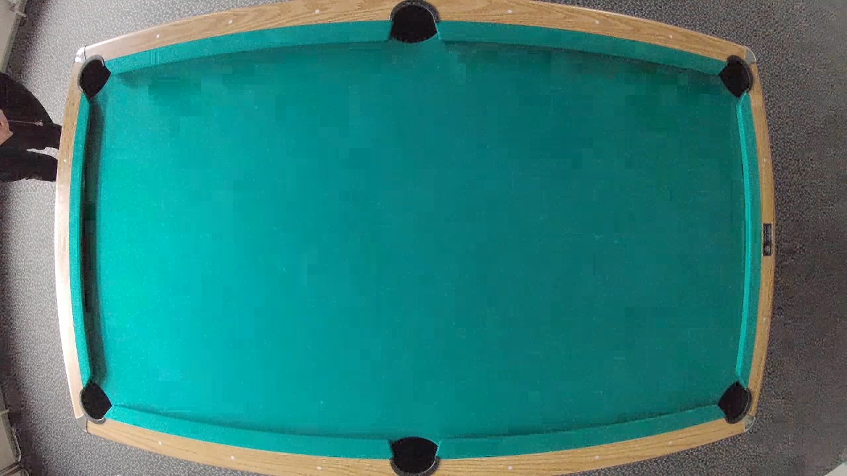
Data Preparation – Lens Distortion
Distortion is one of the 5 basic optical aberrations.
Distortion ∝ d^3
The camera we used causes Barrel Distortion.
Optical axis
Barrel distortion(source:wiki)

Slide 45
CSV Generation
Traverse through entire strike sequence obtained from tracking
Each csv row corresponds to a point/frame in the strike sequence
Row consists of 16*2 coordinates of balls ordered in a predefined way
Mirror/Augment data (see next slides)

Slide 46
Modeling
Synthetic Dataset
Obvious bottleneck for model early into development: training data
Create intermediary synthetic dataset:
Balls at random positions on table
Random linear motion direction of balls
No collisions, but learn linear motion
Keep improving the model until more real data is available
Later in development switch back to real (and augmented) data

Slide 47
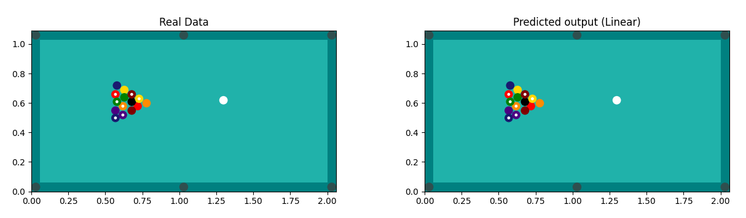
Evaluation
Rendering
Object plotting on layers using Matplotlib
Frame Generation
Video generation using OpenCV
Comparison view

Slide 48
Rendering
Features
Dimensions are an exact scaled version of the original. Colours are as close as possible to the original table.
Solid balls represented as solid circles and striped balls are represented as a solid circle with a white inner circle.
Comparison view of real data and predicted output
Option for video generation as well as on screen display
Support for different representation of different model outputs
Video generation at the rate of 30 frames/s

Slide 49
Rendering
Idea
Prediction output of the model is in the form of a row of 32 float values corresponding to the (x,y) coordinate of each ball with respect to the table.
Difficult to have a cohesive and coherent understanding of the model behavior through plain numeric values.
To get a better idea of the behaviour of the model, with respect to real life ball movement on a billiards table, a visual representation of the numeric values was needed which was close to the original imagery.
Matplotib library was used for frame generation and OpenCV was used for video generation.

Slide 50
Evaluation
Multi-step prediction
N-step prediction easier than full prediction
Can be as simple as singlestep prediction with n=1
Shows short-term mistakes, but no cumulative long-term inaccuracies
Useful to spot mistakes in earlier models
Later switch to full prediction for more advanced models

